Slide 1
Bird-v-Drone
DIPro

Slide 2
Index
Purpose
Method
Pipeline
Noise Filtering
Localization
Object detection
Milestones
Results
Localization
Naive SVM

Slide 3
Purpose
The goal of the project is to build an image classifier that can successfully distinguish between a drone and a bird with sufficient accuracy using only image processing and machine learning techniques, without involving deep learning concepts.

Slide 4
Method
Build an SVM with RBF Kernel
Use features such as HOG, image filters, etc

Slide 5
Pipeline
Noise filtering
Localization
Object detection

Slide 6
Noise filtering
We plan to use some common noise filtering algorithms to remove the salt & pepper noise, etc. and then quantize the image to reduce the sample space of the histogram of oriented gradients (HOG) and improve the accuracy of the same.

Slide 7
Localization
We plan to do the following to localise the object of interest:
Convolve with some edge detection filter.
Binarize the image to run image morphology operators.
Run closening morphology operator to remove small gaps and better segment the objects.
Merge small components with their parents to reduce the number of components.
Run object detection on all the subset of the components.

Slide 8
Object detection
We plan to normalize the component image size for better comparison and then use the following features to predict the probability of being a bird/drone:
The HOG of the given subset of components.
Hough transform with more weight given to straight edges. (Use quantized edge slopes)

Slide 9
Milestones
Milestone | Estd. Date of Completion | Completed?
Analyze different methods | 12/10/2018 | ✅
Build naive SVM | 20/10/2018 | ✅
Find & analyze features | 5/11/2018 | ❌
Modify SVM to include features | 11/11/2018 | ❌
Compare & contrast SVM to current state of the art classifiers | 15/11/2018 | ❌
Prepare final presentation | 18/11/2018 | ❌
Final Submission | 29/11/2018 | ❌

Slide 10
Results

Slide 11
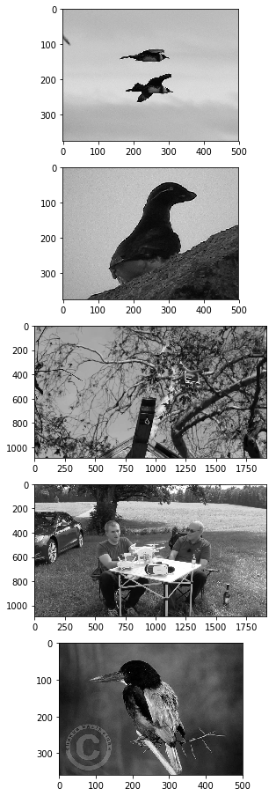
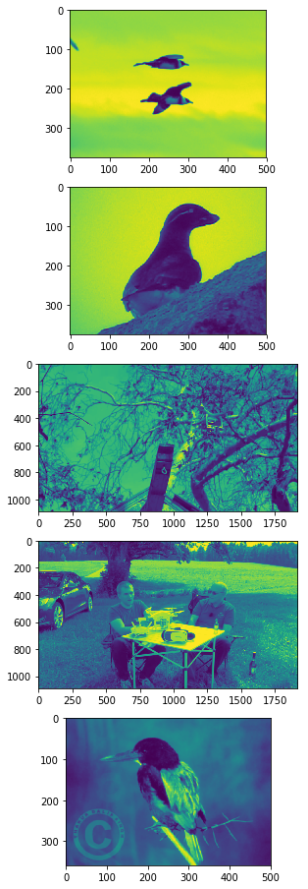
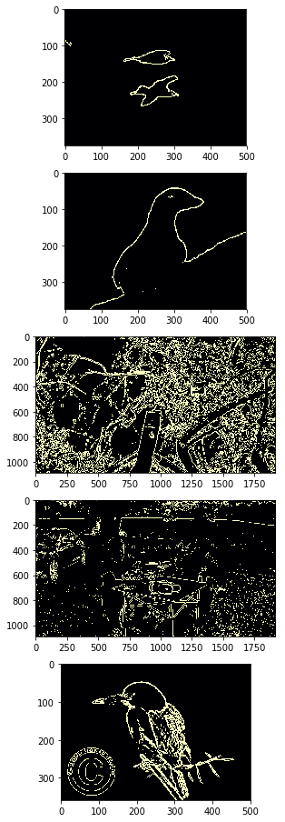
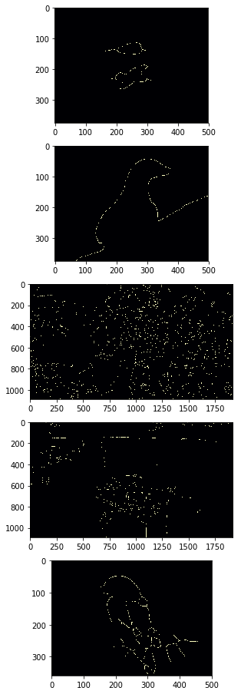
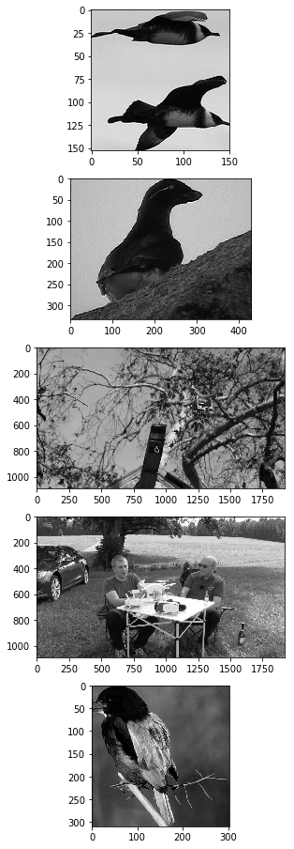
Localization

Slide 12
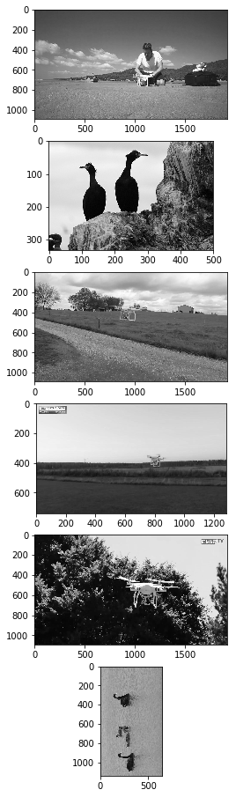
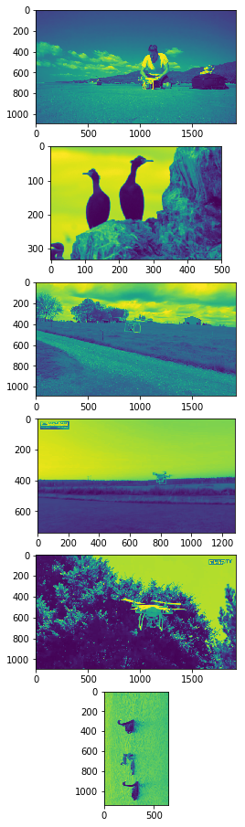
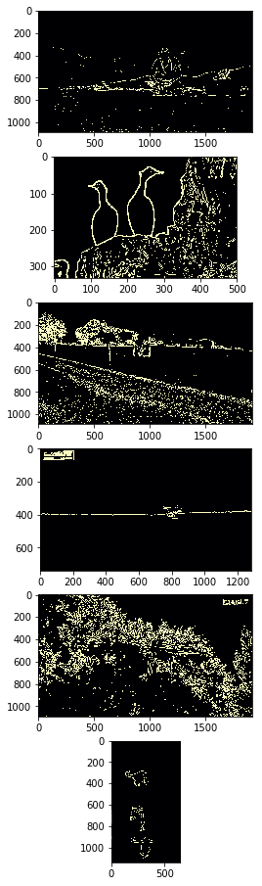
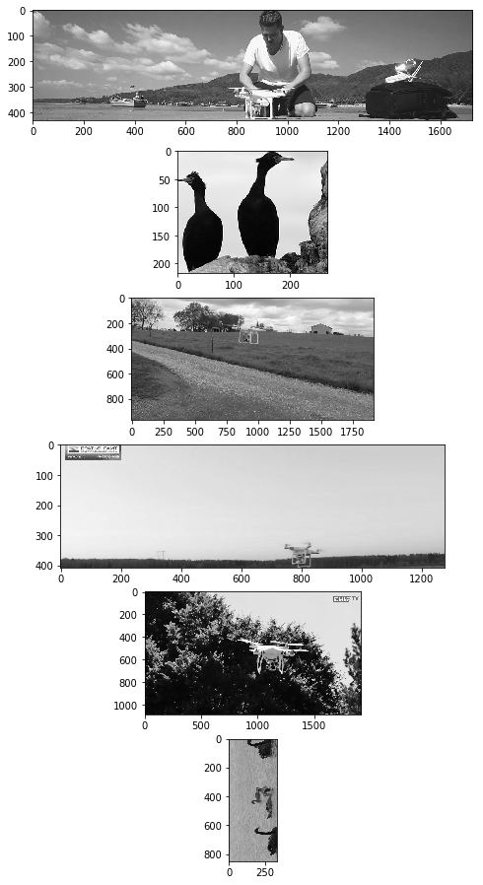
Localization

Slide 13
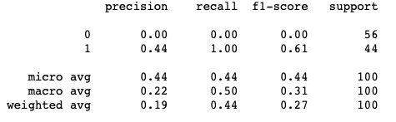

Naive SVM

